Slide 1
Open Sesame
Micheal Hatch & Philip Vickers
Abstract: A hands free car door opening App. This App allows for your car door to open or close without using your door handle.

Slide 2
AGENDA
Introduction
Primary goals
Schedule
Hardware
Architecture and Design
Website
Live Demonstration

Slide 3
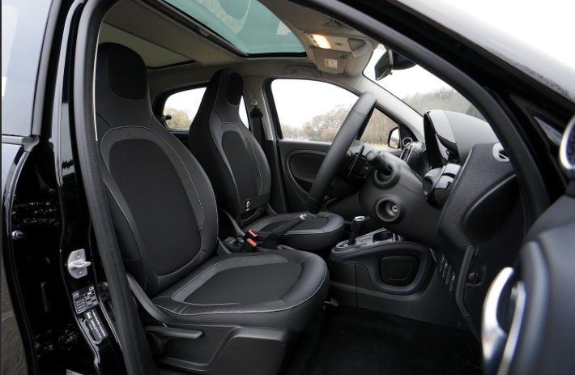
INTRODUCTION
How many times have you wished you had an extra hand when getting into your car? Well, wish no longer with Open Sesame. A voice activated App that opens and closes your car door for you.

Slide 4

PRIMARY GOALS
Hands Free Operation
Communication between App and Vehicle
Safety Features

Slide 5
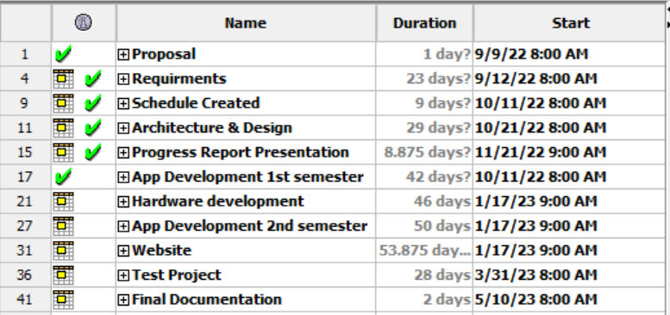
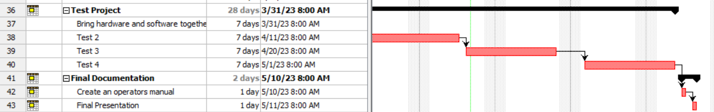
Schedule
Gantt Chart kept us on track.
Created a clear picture for the team to follow.

Slide 6
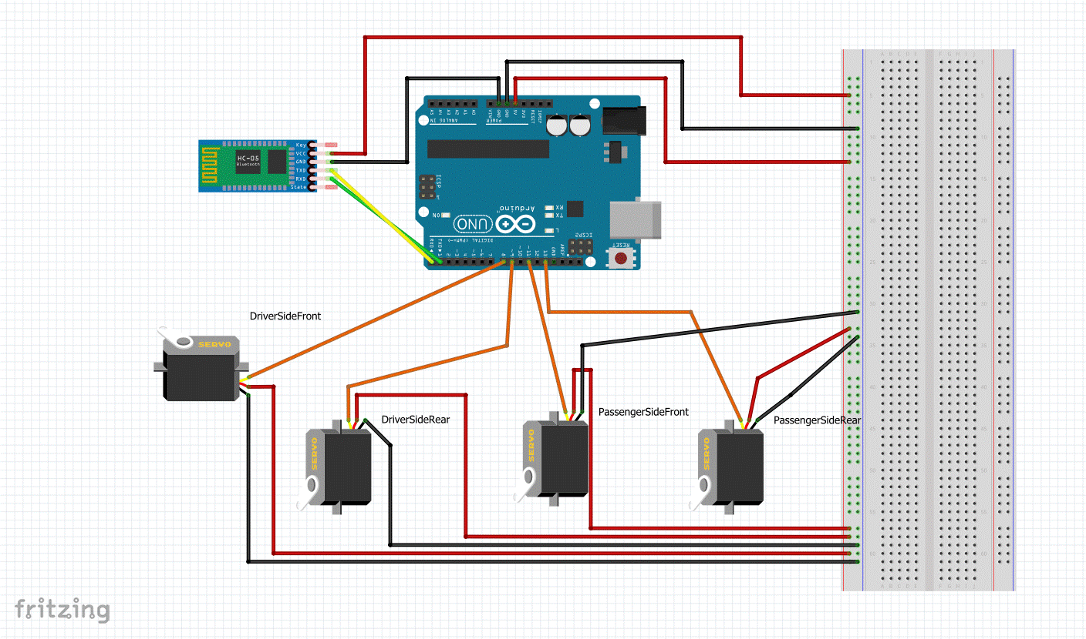
Hardware System
Arduino Uno
4 Servo motor
HC-06 Bluetooth module

Slide 7
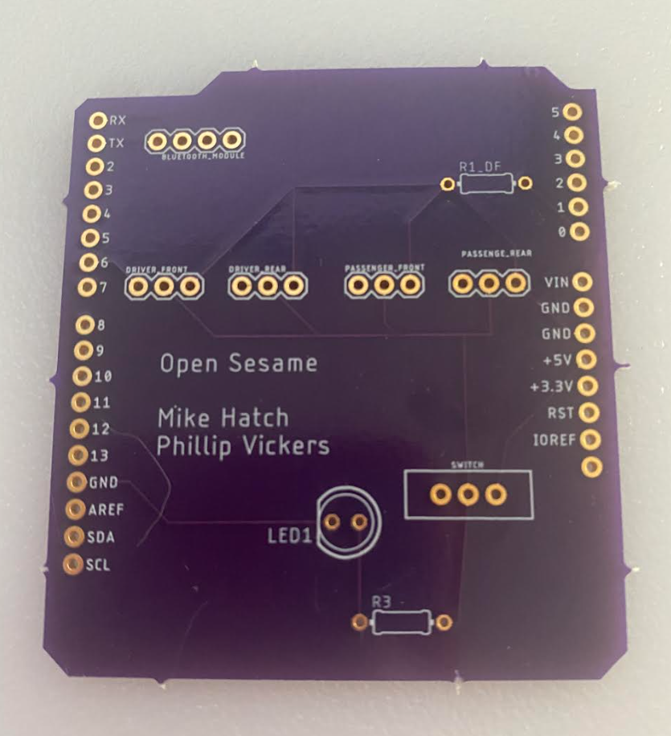
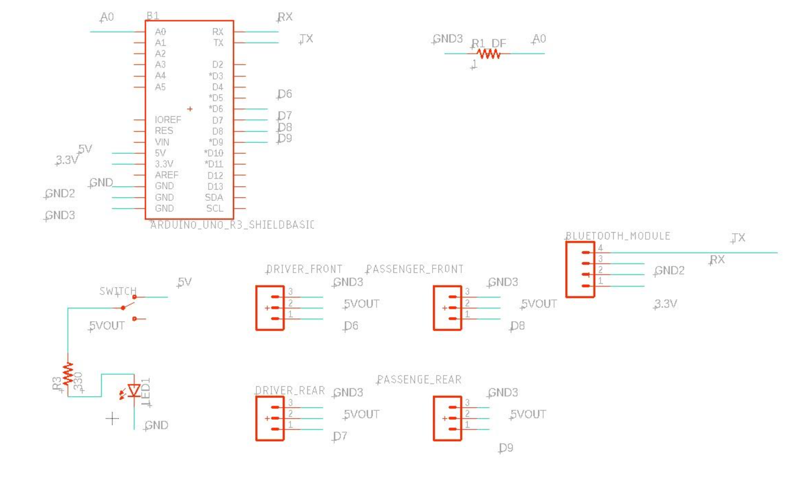
Architecture and Design
Circuit Board
Schematic

Slide 8
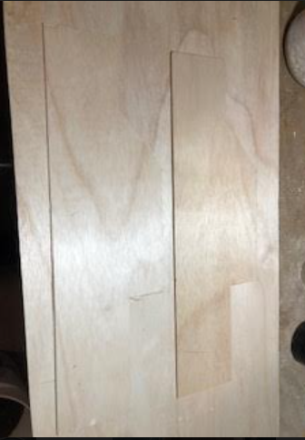
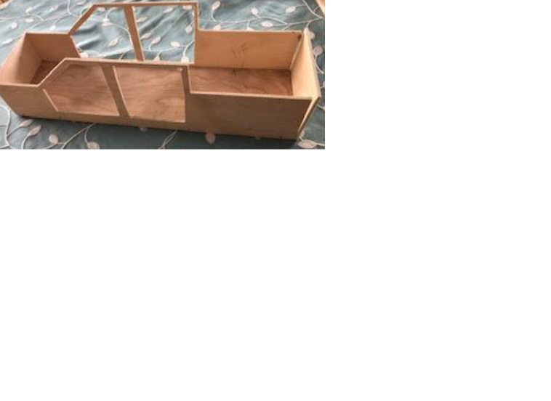
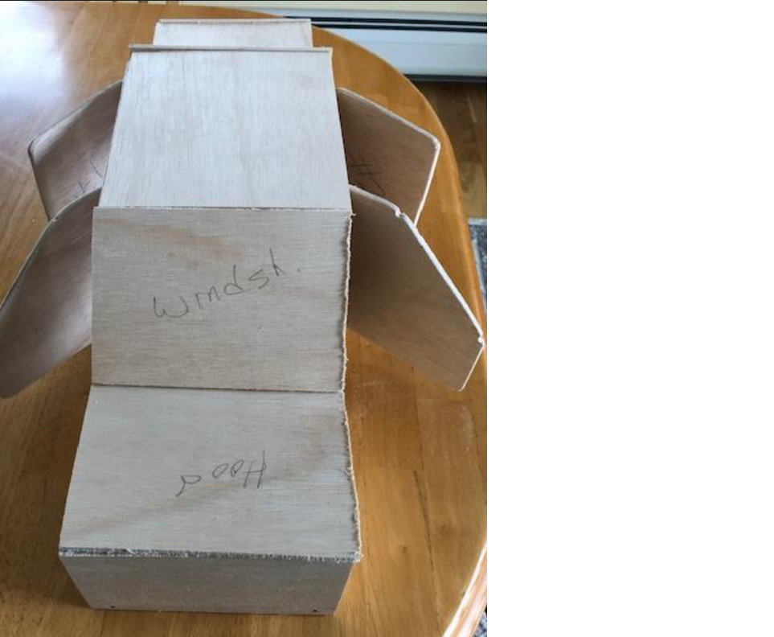
Prototype Model
One challenge was finding a proto-type vehicle that would fit our components. We created one from scratch.

Slide 9
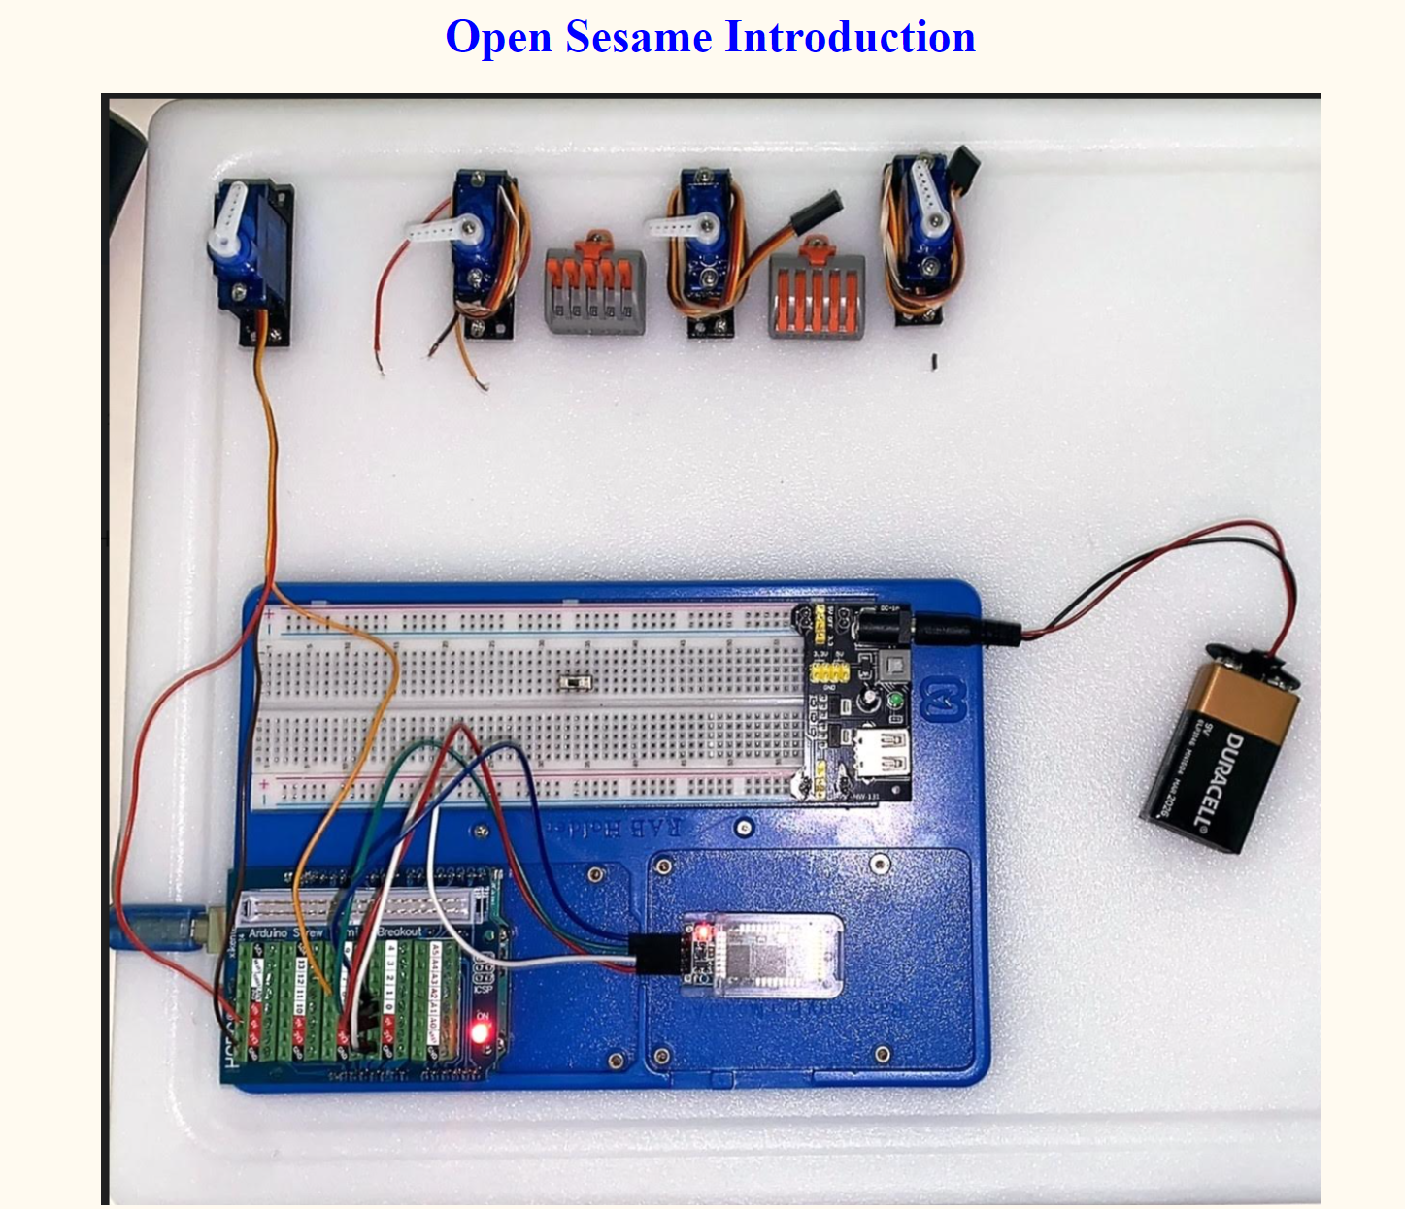
Website
Link to the website.

Slide 10
Live Demonstration

